Slide 1
Learn to Create Better Models with Units of Measurement
September, 2014
Chris Kuip

Slide 2
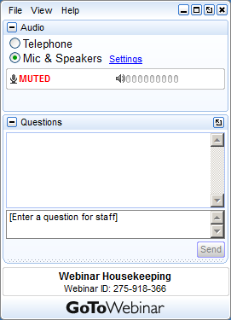

GoToWebinar Housekeeping: time for questions
Your Participation
Please continue to submit your text questions and comments using the Questions Panel
Please raise your hand to be unmuted for verbal questions.
Note: Today’s presentation is being recorded and will be provided within 48 hours.
Notes:
Remind Attendees how to ask questions and provide “more info” or support contact. Text may be adjusted to suit your event needs. Note: Hand Raising is enabled (see slide 4)
Visit the “Options” menu in the Organizer control panel a check to allow attendees to Raise Hands.

Slide 3
Learn to Create Better Models with Units of Measurement
September, 2014
Chris Kuip

Slide 4
Testimonials from our partners
For the end-user:
“Problems involving lots of entities tend to require different units, even within the same dimension. For instance, in OCC some SKU are input as “ton” while others are input as kg or even g. It is more natural than requiring users to do manual conversion (like forcing them to convert everything to kg in Excel before input). Internally we can have identifiers in ton for example but show them in kg in reports (by adjusting pivot table settings). AIMMS does all the conversion for us.”
For the developer:
“We are free to model with whatever unit we want. If the user asks us to change units in GUI, it's just a visualization matter. As the model grows, having all identifiers with units helps avoid inconsistencies in expressions and constraints. For example, if a parameter that expects a “ton/day” value receives “ton” AIMMS raises a warning, so we can fix the assignment and/or its units. As AIMMS does all the conversion for us, we don’t need to worry. I can happily assign a “kg” value to a “ton” parameter and it just works.”

Slide 5
Units of Measurement (UoM), intro
UoM give meaning to data, compare:
15
15 [m]
On the globe several different UoM systems are known. The two most common ones are:
Imperial, used in trade, UK, and USA
Metric, used in scientific world, Europe, Asia, and Australia
Obviously, having multiple UoM systems leads to, costly, confusions:
In 1999 the Mars Climate Orbiter, worth 125M$, crashed.
Final analysis report was signed by 10 managers at NASA.
Root cause: Inconsistent use of UoM communicating some small but significant forces between selected software components.
Recommendation: Verify the consistent use of units throughout the spacecraft design and operations.

Slide 6
Intro Question
Please take on the role of program manager. You want to avoid disasters such as the one just described. For a new project, what do you choose?
Everything Imperial, most USA citizens are used to it
Everything Metric, scientists, most Europeans are used to it
Up to each developer, ensure proper documentation
For each user, allow customization
Decide per project one of the above, as appropriate
Poll: think about it for a minute
By now you probably realize this is a trick question.
Claim: with AIMMS, no need to make this choice:
Every stake holder can use customary UoM

Slide 7
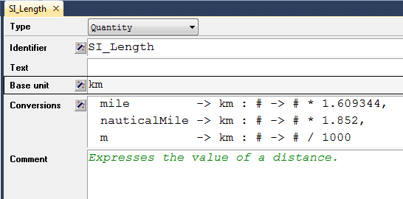
Demo 1: Declaring units.
Quantity (what do we measure, which units do we use):
Create quantity SI_Length
Add conversions for miles and km by point and click
Add conversion for nautical miles, factor 1852, by editing attribute
Switch to basic unit km (model granularity)
Designing a circuit board has a different base unit than flight planning.
Notes:
A strategic forestry model may use 5 year periods making up a 170 year horizon
A dairy truck routing application may use 10 minute periods making up an 8 hour working day

Slide 8
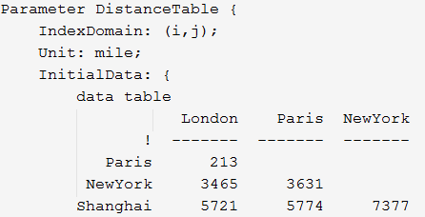
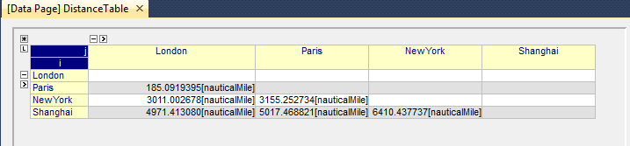
Demo 1 continued: Associating units
Add unit mile to an existing parameter
Show data page, with units per value in nauticalMile

Slide 9
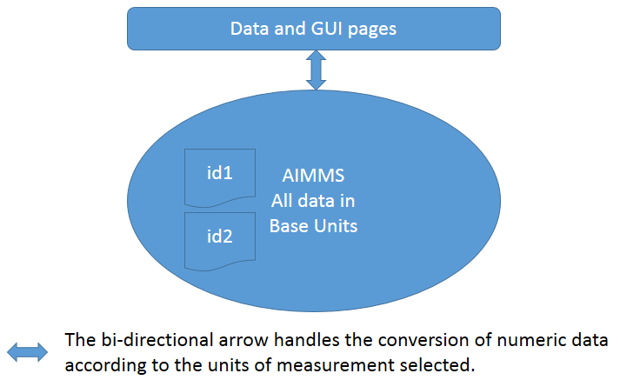
Units of measurement – AIMMS under the hood
AIMMS stores all numeric data according to the base units selected for the quantities
Whenever AIMMS communicates numeric data it will convert that data according to the selected units

Slide 10
Conventions
A group of people with a common background, use the same UoM for measuring. For instance:
Europeans: distance between cities, by convention, in km
USA citizens: distance between cities, by convention, in miles
A convention is an agreed upon collection of units, according to which numeric data is viewed, typical examples:
convImperial, units such as pound, gallon, second, and yard
convMetric, units such as kg, liter, second, and m

Slide 11
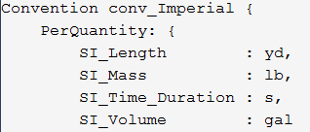


Demo 2: Adding conventions
The convention conv_Imperial
The element parameter ep_currConv
The attributes of the main model

Slide 12
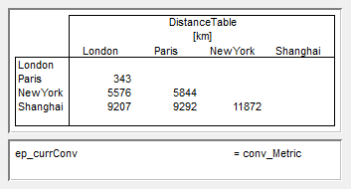
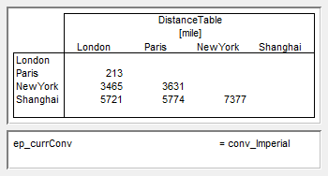
Demo 2 continued: Using conventions
The distance table according to both conventions:
Paris – London 343 [km] or 213 [mile]
Note the use of the unit in the header
Control via ep_currConv

Slide 13
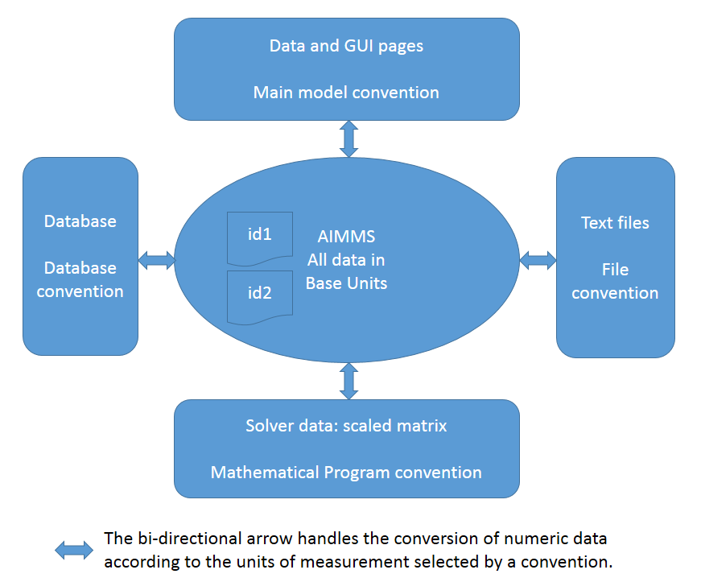
Conversions according to conventions
All communication channels:
AIMMS’ interaction on numeric data can also go via text input files and via databases. There is also interaction with solvers. In all of these communication channels, the selection of units can be controlled via conventions

Slide 14
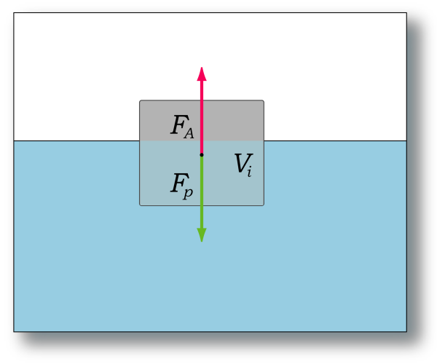
Unit consistency, poll
Archimedes law:
weightBody in [kg]
volumeBody in [m3]
densityFluid in [kg/m3]
Possible formulas for afloat test:
weightBody * densityFluid < volumeBody
weightBody < volumeBody * densityFluid
Which test is unit consistent?
A.
B.
Both.
Neither.
Does not matter.

Slide 15
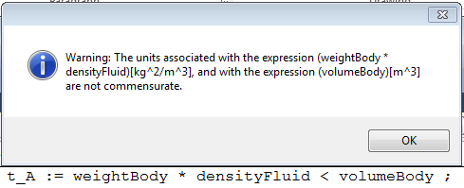
Demo 3: AIMMS way of answering poll
Demo with AIMMS or
Click to open:

Slide 16
Unit casting
Escape clause:
totalObjective := ( w1 * obj1 )[-] + ( w2 * obj2 )[-] ;
When you feel you need it often; rethink.

Slide 17
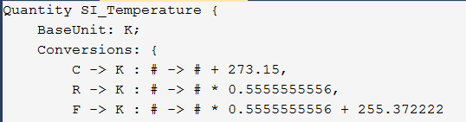
Special case: Temperature
Celsius and Kelvin
Fahrenheit and Rankine
To increase the temperature of a body of 1 kg by 1 degree a certain amount of energy is needed:
unitEnergNeededIncrTemp in [ J / kg * K ]

Slide 18
Remarks
Logarithmic units, such dB (decibel) for sound, are not supported
Units of measurement are not a panacea. They have to be used when necessary, otherwise an overkill of units might cause an application to be more complex than it should be. For instance, introducing units where integral value are expected such as numberOfPlanes.

Slide 19
Next Webinar
Marcel Hunting
October 15
Introduction to Generated Mathematical Programs
Fast updates
Solution repository

